Slide 1
Implementation
Community Detection – Modularity Maximization
Community structure detection by maximizing modularity
  dense connections within communities, sparse between communities
Steps:
  For every possible merge (or node move between communities), compute the change in modularity if that merge/move is made.
  Find the merge (or node move) that gives the largest positive and update the community structure accordingly.
  Recalculate modularity gains for the new community structure, and repeat Step 2 & 3 until no operation can further increase modularity.
  Among all intermediate partitions during the process, choose the one with the highest modularity as the final community structure.

Slide 2
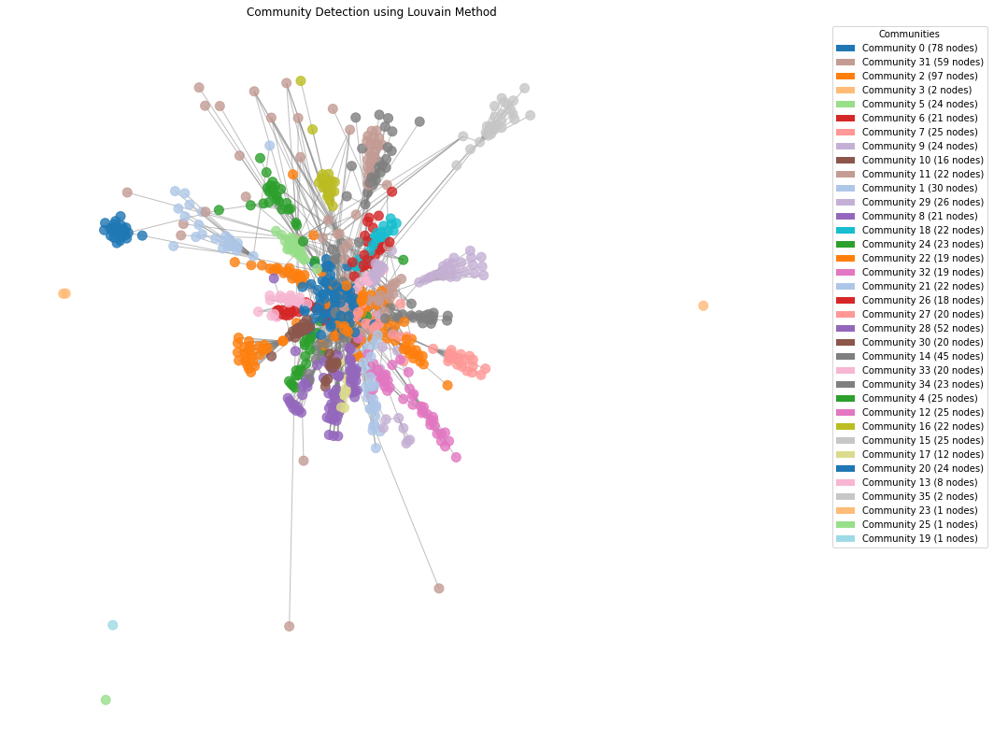
Community Detection: Louvain
Number of Communities: 36
Modularity Score: 0.828
Total Internal Edges: 1424
Avg. Internal Density of Communities: 0.081

Slide 3
Community Detection: Leiden
Number of Communities: 33
Modularity Score: 0.789
Total Internal Edges: 1567
Avg. Internal Density of Communities: 0.093

Slide 4
Community Detections: Comparison
 | Graph Structural Dismantling | Label Propagation | Modularity Maximization
Algorithms | Girvan-Newman | LPA | Louvain | Leiden
Number of Comm. | 36 | 72 | 36 | 33
Modularity | 0.750 | 0.693 | 0.828 | 0.789
Avg. Internal Density | 0.073 | 0.071 | 0.081 | 0.093
Modularity Maximization Method presents a more stable structure and high-quality performance
Leiden is adopted in later analysis as it offers a more balanced overall performance, with a higher modularity, least fragmented structure, and the highest internal cohesion.

Slide 5
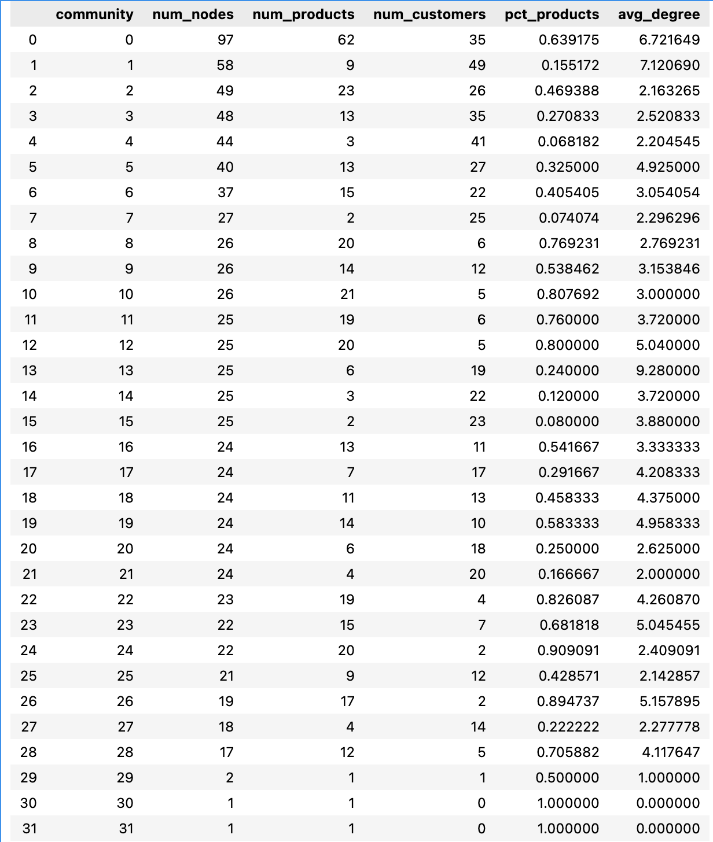
Analysis:
Comm. Composition
The subgraph has no giant clusters, indicating a multi-centric, multi-cluster structure
Most of the communities range from 20-30 nodes
  community structure is dispersed with pronounced modularity

Slide 6
Analysis:
Comm. Composition
pct(%)_products: varies from 0.06 to 0.9+
  “product-heavy vs. customer-heavy” approaches:
  1. product-heavy(% > 0.5): A small number of customers connected to a large number of products.
    Strong category depth & relatively concentrated and possibly repetitive user behavior
  2. customer-heavy(% < 0.5): A large number of customers are concentrated around a relatively small number of products
    Community behavior is determined by “user behavior patterns,” not by product structure
  3. mixed balanced cluster(% ~ 0.5)

Slide 7
Analysis:
Comm. Composition
avg_degree: extreme variation
  some communities(>5) are tightly knit while others(<=3) exhibit extremely loose structures
  1. high-density: stable structure with strong cohesion
    products: reviewed by lots of users
    customers: reviewing on products frequently/ posting high quality reviews(high numbers of "votes" & "helpful")
  2. low-density: loose structure & diverse community connection --> tends to be "explorative users" or "first-time customers"
    products: niche products
    customers: low engagements/ newcomers/ browsers

Slide 8
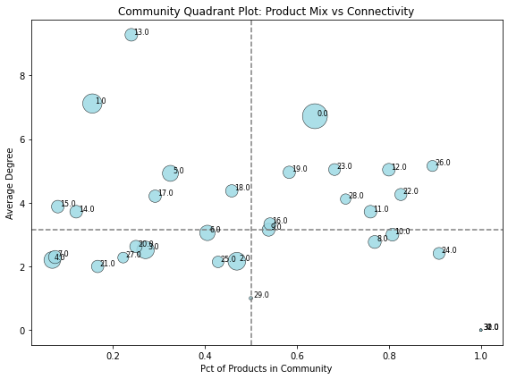
Analysis:
Persona Profiling
1. Categorial Core Shoppers / Category Deep Divers:
  product-heavy + high density community
  Example: Community 0 (97 nodes)
large amount of products & few highly active customers
category-driven cluster
user profiling:
  loyal buyers with highly concentrated interests in specific categories
  long-term customers, not one-time buyers
  a small set of highly active customers engage with a large set of closely related products
  a major product category with strong co-purchase or co-review behavior

Slide 9
Analysis:
Persona Profiling
2. Fan Clusters / Star-product Buyers:
  customer-heavy + high avg_degree community
  Example: Community 1 (58 nodes)
high avg_degree: customers engage intensely, leaving high-quality reviews and browsing on the same groups of products frequently
strong community-driven behavior, possibly a fandom cluster or viral product segment
user profiling:
  power influencers
  high-volume trend followers clustered around a few blockbuster products
  frequently review on popular contents
  driven by popularity signals rather than category depth

Slide 10
Analysis:
Persona Profiling
3. Casual shoppers:
  mixed balance + low-engagement & low-inner-bonding community
  Example: Community 2 (49 nodes)
balanced ratio of products and customers: users interact with a variety of items that are not strongly related to each other.
user profiling:
  non-specialized, low-commitment browsing behavior
  general-purpose shoppers who browse across multiple categories
  customers exploring different types of products

Slide 11
Analysis:
Persona Profiling
4. Occasional Buyers / Comparison Shoppers
  customer-heavy + low-engagement community
  Example: Community 3 (48 nodes)
low interactions & commitments, but sharing overlapping interests
user profiling:
  new customers entering a specific category for the first time
  occasional buyers with focused but shallow engagement
  potentially “one-time demand”
  customers evaluating a few similar products (substitutes) before making a choice

Slide 12
Analysis:
Persona Profiling
5. Browsers / Potential Customers:
  product-heavy + low-density community
  Example: Community 8 (26 nodes)
customers browsing various products with low correlations
user profiling:
  random visitors
  no specific browsing direction and minor engagement
  early stage of purchasing initiation

Slide 13
Business Insights:
Targeted Strategies
Categorial Core Shoppers | Fan clusters / Star-product Buyers | Casual shoppers | Occasional Buyers | Browsers / Potential Customers
Product-heavy | Customer-heavy | Mix-balanced | Customer-heavy | Product Heavy
High density | High engagement | Low engagement | Low engagement | Low density
In-category deep recommendations | Limited effectiveness of personalized recommendations | Explorable, wide-coverage entry products | not suitable for deep personalization / content-based
Cross-sell complementary products | Promotion on trending products/boosting viral items | Help users to spark interests on a category, not deepen their understanding | Introduction recommendation of diverse products to capture interests

